Slide 1

Measuring the efficacy of Gestalt therapy to treat depression in people with dementias
«GESTALT FOR FUTURE – CREATING A NETWORK FOR RESEARCH»
HAMBURG, 2ND TO 4TH SEPTEMBER 2022
Presenter: Alessandra Merizzi, psychology researcher at IRCCS INRCA, National Institute of Health and Science on Aging, Centre for Socio-Economic Research on Aging
In collaboration with Rosanna Biasi & Fernando Alvarez Zamudio

Slide 2

dementia or dementias?
WHAT IS IT OR WHAT ARE THEY?
Dementia is an umbrella term to describe cognitive and behavioural symptoms that occur when the brain has a particular disease or condition
Dementias are caused by more than 100 diseases

Slide 3
THE MANY SYMPTOMS OF LIVING WITH DEMENTIA
Forgetting: STM and prospective memory
Poor judgment and difficulty planning: reasoning, problem solving
Communication difficulties: verbal fluency, speech production, reading, writing
Confusion of space and time: orientation
Depression, changes in personality
Misplacing items: visuospatial representation and attention, identifying, naming
Difficulty doing familiar tasks: reaction time, working memory, attention
Notes:
STM: lemon, key and ball

Slide 4

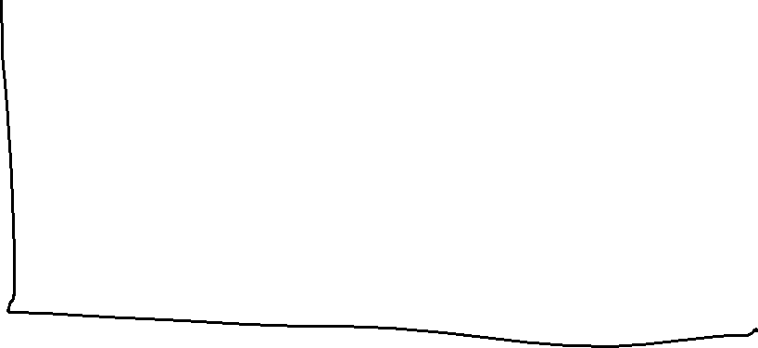
The MANY DEMENTIAS: most common types
VASCULAR DEMENTIA 10-20%
Dependent
AD 60-70%
FTD 2%
SUBCORTICAL
STROKE
PARKINSON’S DEMENTIA 2%
LEWI-BODY 4%
Independent
Mental
Physical
Notes:
Subcortical Vascular Dementia. Subcortical vascular dementia, also called Binswanger's disease, is caused by widespread, microscopic areas of damage to the brain resulting from the thickening and narrowing (atherosclerosis) of arteries that supply blood to the subcortical areas of the brain.

Slide 5
The stigma of AGING AND dementia
Is it normal to develop dementia as people age?
Can people with dementia learn anything new?
Do only older people aged 75+ develop dementia?
Does dementia make people stupid or mad?
Is it helpful to maintain hobbies and interests for someone with dementia?
Can people with dementia speak for themselves?

Slide 6
«If you have met one person with dementia, you have only met one PERSON. That is, each individual will talk, act, remember and behave differently, not simply because of what stage (and type) of dementia they are in, but because THEY ARE WHO THEY ARE.»
By Unknown
«Those with dementia are still people and they still have stories and they still have character and they are all individuals and they are all unique. And they just need to be interacted with on a human level.»
By Carey Mulligan, actress and Dementia Friends Ambassador
Notes:
Things do not exist; every event is a process; the thing is merely a transient form of an eternal process. Everything is in a flow

Slide 7
Experiences of living with dementia
«I’m choosing an attitude of dancing with dementia. I’m choosing to be a survivor. I’m choosing to live my life positively everyday. I love the imagery of a couple dancing with dementia. It’s a couple, a care-partnership, in which we move together. We sense each other’s needs, and change and adapt according to the changing music of the journey with dementia. It’s a very expressive way I think, of talking about the care partnership being like a dance with dementia. … as care-partners in the dance with dementia, we both have to learn to LISTEN to the music. What is happening to me, to us? What is the rhythm of our dance with dementia? … Professionals, family, friends provide cues and support for our dance with dementia. And they should be watching us dance, not playing their own music! …»
By Christine Bryden, diagnosed with dementia at the age of 46, author of the book “Dancing with dementia”

Slide 8
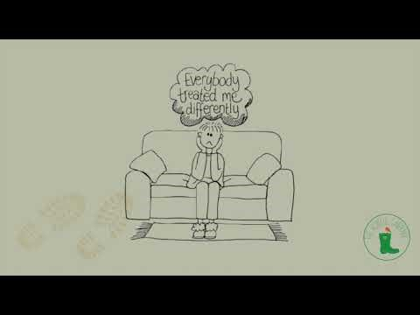
The experience of diagnosis
Notes:
https://youtu.be/n9E_8fjZfk0

Slide 9
THE EXPERIENCE OF DIAGNOSIS
- DEEP is a beautiful association, an opportunity for people living with dementia that exists in the UK
However, not everyone has the same character as Dory, e.g., there are individuals whose creative adjustment is to withdraw
Furthermore, there are countries like Italy and Mexico where realities like the DEEP network do not even exist at all – there are some charity organisations such as Alzheimer’s cafes but not groups in which PWD are the protagonists
Most importantly, there are not dementia services that provide enough support at diagnosis and post-diagnosis

Slide 10
DEMENTIA AND DEPRESSION: there is more
History of depression
The experience of diagnosis
Difficulties adjusting after diagnosis
Organic changes in the brain due to dementia (some types, sometimes)
Common risk factors for depression in old age e.g., social isolation and bereavement

Slide 11
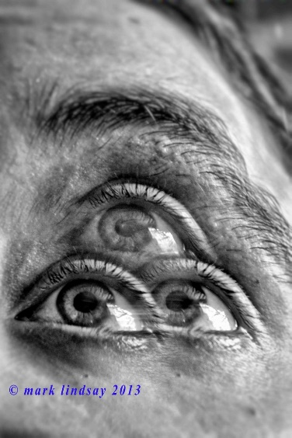
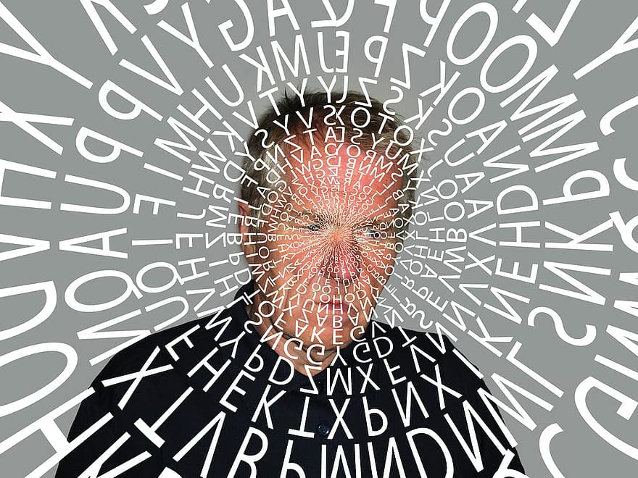
DEMENTIA OR DEPRESSION?
DEPRESSION
Difficulties concentrating
Says «I don’t know»
Consistent low mood
«Gives up»
Orientation to time, date and place remain intact
DEMENTIA
Short term memory problems
Will give an answer
Mood variation (good days/bad days)
Has a go
Confusion to time, date and place

Slide 12


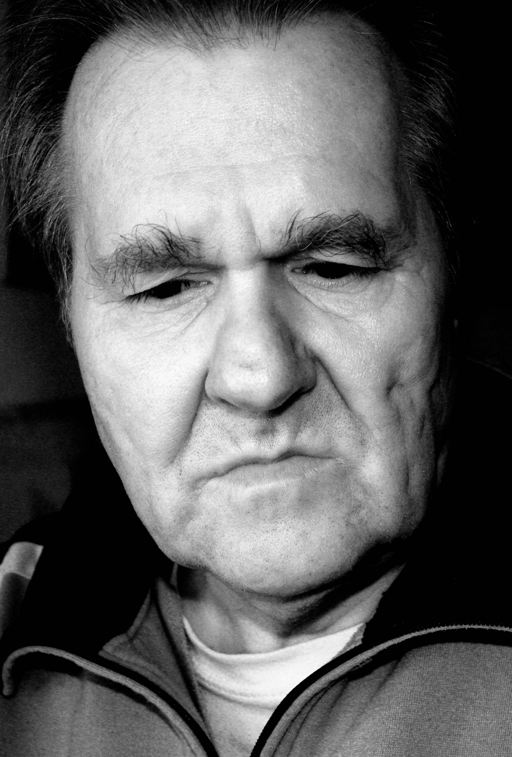
DEMENTIA & DEPRESSION
Apathetic and less cooperative
More confused and forgetful
Change in the family field
Family members can feel frustration and anger
Guilt and shame
Powerless and depression
Increased level of psychological and physical stress
Physical health of both can be affected e.g. faster progression of dementia

Slide 13
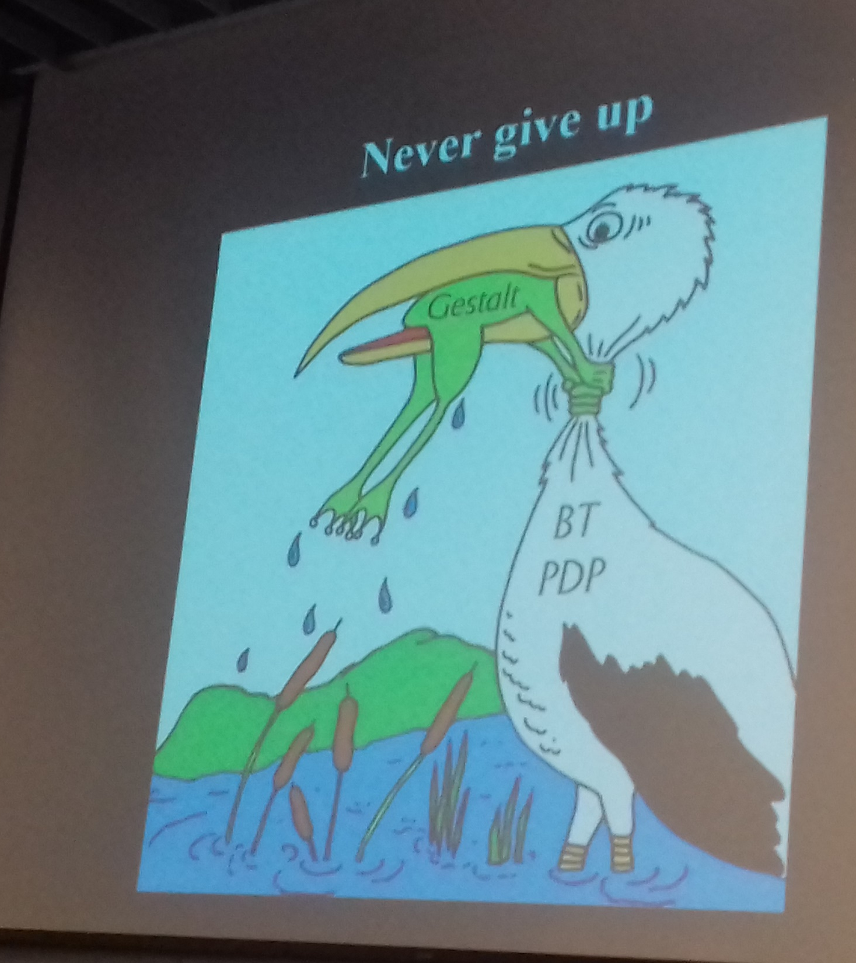
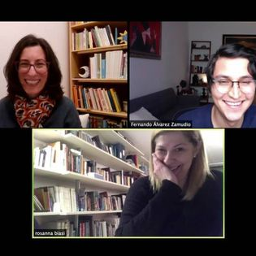
Our project: how did we start?
Notes:
(Stork)
Rosanna: my experience is that we all love to work together and to know differences about pathology and services in different countries. At the same time, we are sure that doing research needs an international network and our collaboration is only a starting point.

Slide 14

Our aims
To measure the efficacy of GT with People with Dementia (PWD)
To do research in GT and contribute to its evidence
NARROW DOWN THE FOCUS:
PWD and Depression (mild)

Slide 15
The situation in each country
ITALY
MEXICO
Over a million of PWD which will double by 2050
New diagnostic services (2017): Centri per Disturbi Cognitivi e Demenze (CDCD)
Lack of post-diagnostic support
PWD live in the community with (less than) minimal support
Charities provide some support
Difficult to find professional support for PWD and family/informal carers
Epidemiology is predicted to raise to 1,5 million by 2030
New national plan: Alzheimer’s Plan of Action (APA)
Many families living in rural areas and poor condition do not have access to services
Community-type of support, BUT not professional or based on empirical evidence

Slide 16

What gestalt can bring as intervention with pwd?
Emotional and procedural memory are retained skills
GT works on emotional and procedural memory!
Focus on creative adaptations
Focus on resources, possibilities and alternatives

Slide 17

What gestalt can bring as intervention with pwd?
Focus on the dance for finding the rhythm of our dance with dementia!
GT does not play its own music, but contributes to easing the experience of dancing with dementia
Notes:
To quote the words of Christine Bryden

Slide 18

Let’s introduce our research proposal
Our research questions are:
1. Is there any pre/post treatment improvement?
2. If the answer to question 1 is yes, is the change clinically significant (reduction of symptoms by 50%)?
3. If loneliness is a factor, is the improvement solely due to the social contact with the therapist? OR
4. Can the improvement be attributed to the therapy intervention?
5. Can the improvement of the patient also have an impact on the caregiver’s burden and level of mutuality?

Slide 19
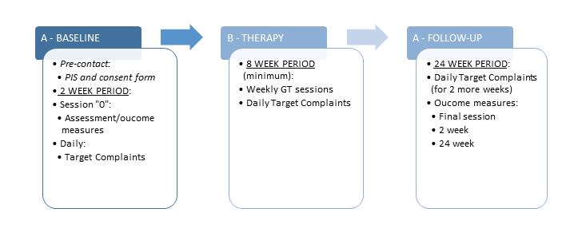
Research design: single-case experimental design

Slide 20
Sample:
PWD and depression (n. 12)
INCLUSION CRITERIA
Provide evidence of formal diagnosis of dementia
Have mild dementia (CDR-SOB score 3-9)
Be able to engage in therapy
Have mild depression (GDS score 10–19) and/or anxiety (NPI-A score ≥ 4)
Psychopharmacological treatment = during the investigation
live in the community
Notes:
clinical dementia rating–sum of the boxes (CDR-SOB)

Slide 21
Sample:
PWD and depression (n. 12)
EXCLUSION CRITERIA
dementia at a moderate–severe stage (CDR-SOB score 9.5-18)
Challenging behaviours, delusions, or psychotic symptoms or major depression (GDS score 20–30)
High risk/safeguarding issues
Parallel therapy on same TC
Variation in psych drugs
admission to hospital or residential care
Notes:
clinical dementia rating–sum of the boxes (CDR-SOB)

Slide 22
Sample:
Gestalt psychotherapists (n. 6)
INCLUSION CRITERIA
Agree to participate and comply to the research rules
Be state licensed Gestalt psychotherapists, with previous experience of working with PWD
Have access to Gestalt supervision

Slide 23
Instrument | Variable | Point of view | When it is used
Neuropsychiatric Inventory (NPI) | Neuropsychiatric symptoms (patient) and Caregiver Distress | Expert judge interviews caregiver | Session “0”
Clinical Dementia Rating (CDR) | Cognitive symptoms and dementia diagnosis | Expert judge interviews patient | Session “0” and follow-up
Geriatric Depression Scale (GDS) | Depressive symptoms | Patient self-report | Session “0”, final session and follow up
Anxiety indicated by an NPI-A score of 4 or more | Anxiety symptoms | Expert judge interviews Caregiver | Session “0”, final session and follow up
Target Complaints (TC) | Specific results of therapy | Patient self-report (after co-construction of instrument with a therapist) | Co-constructed at session “0”. Client completes questionnaire every day after that until follow up session
University of California, Los Angeles loneliness scale version 3 (UCLA-LS3) | Loneliness | Patient self-report | Session “0”, final session and follow up
Quality of Life-Alzheimer’s Disease (QOL-AD) | Quality of Life | Expert judge interviews patient and family caregiver self-report | Session “0”, final session and follow up
Ad-hoc Common Assessment Tool | Level of care | Family member self-report | Session “0”
Zarit Burden Inventory (ZBI) | Caregiver level of stress | Family member self-report | Session “0”, final session and follow up
The Mutuality Scale | Mutuality of relationship | Patient and caregiver self-report | Session “0”, final session and follow up
Clinical Outcomes in Routine Evaluation–Outcome Measure (CORE-OM) | Overall results of therapy | Patient self-report | Session “0”, final session and follow up
Gestalt Therapy Fidelity Scale (GTFS) | Treatment fidelity | Expert judge observes therapy sessions | End of first therapy treatment

Slide 24

And what about the statistical analysis ?
For understanding what steps, theories and author to consider:
  We consulted the «GT SC-TS design, manual for researcher» published by Herrera et al., 2017
  We also consulted Mirko Di Rosa, statistician and econometrician at INRCA - National Institute of Health and Science on Aging, Unit of Geriatric Pharmacoepidemiology and Biostatistics

Slide 25
Strengths and limitations of our project idea
Strengths | Limitations
GT has never been investigated as a treatment for depression in PWD | Funding!
The holistic, experimental, creative and flexible nature of GT plus the stimulation of procedural memory: GT is a good candidate | Covid or other unexpected events: the project may include a number of online-therapy cases
The SCED-TS can ensure high-quality research for small heterogeneous groups in clinical settings | A mixed-method design study: qualitative data may add value to the quantitative data
We have already published a paper on the research protocol in an OA journal: anyone can replicate it! | Recruitment of PWD and depression AND of GT colleagues with experience in the dementia field

Slide 26

OUR RESEARCH PROTOCOL PAPER
Merizzi, A.; Biasi, R.; Zamudio, J.F.Á.; Spagnuolo Lobb, M.; Di Rosa, M.; Santini, S. A Single-Case Design Investigation for Measuring the Efficacy of Gestalt Therapy to Treat Depression in Older Adults with Dementia in Italy and in Mexico: A Research Protocol. Int. J. Environ. Res. Public Health 2022, 19, 3260.
Available for free at: https://doi.org/10.3390/ijerph19063260

Slide 27
What about now?
National Institute of Health and Science on Aging – IRCCS-INRCA (IT)
Institute of Gestalt HCC Italy
Instituto Humanista de Psicoterapia Gestalt (IHPG)
IRCCS Associazione Oasi Maria SS. ONLUS

Slide 28
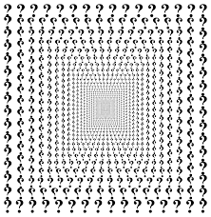
Any questions ?

Slide 29

Alessandra Merizzi
INRCA - National Institute of Health and Science on Aging
Research Department - Centre for Socio-Economic Research on Aging
Via Santa Margherita, 5
60124 Ancona, Italy
E-mail: a.merizzi@inrca.it
Website: www.inrca.it
Rosanna Biasi: rosanna.biasi@gestalt.it
Fernando A. Zamudio: fernandoalvarezzamudio@gmail.com

