Slide 1
Results from a SCTS project with patients suffering from anxiety
Pablo Herrera Salinas, PhD
Jan Roubal, MD, PhD
Phil Brownell, MDiv, PsyD
Illia Mstibovskyi, PhD
Notes:
Presentarme

Slide 2
Outline
Introducción: una historia… Otto y peligro de perder libertad de usar el modelo que me hace sentido; luego volver y pensar en alumnos repitiendo el modelo del gurú sin pensamiento crítico aplicado a la Gestalt; tb pensar en modelos de intervención que nos parecen tan buenos pero no salen de nuestro centro porque no tienen “apoyo empírico” y nos quedamos con que es un puro acto de fe seguirlos o no…
# 1. We need to do empirical research. Why? Several reasons
- Political
- Academic
- Clinical (example poor efficacy with anxiety disorders)
# 2. We need methods for doing research that fit our practical reality and epistemological views.
## Typical methods don’t fit or are not realistic for us
RTC
## STSC fits… because:
### SCTS está validado por la comunidad
### SCTS es aplicable por un clínico o una comunidad de practicantes.
Mostrar que es fácil de aplicar, damos apoyo, dar ejemplo de paciente durante el proceso…
### SCTS calza (más que otros métodos al menos) con nuestra epistemología
### SCTS nos permite explorar el proceso de cambio
# 3. An example with anxiety
## Why anxiety: conclusions from Angus et al 2014
## Efficacy results
## Initial process results (examples)
# 4. How to join and get support
# 5. (For discussion) Learning experience: do’s and dont’s

Slide 3
Why did we start doing empirical research in chile?
From almost no one finishing their final dissertation to dozens of case studies in a few years
Notes:
5 years ago... Otto came to Chile... “Gestalt Therapy in Germany is dying”
Genoveve: “You can use that, but don’t say it’s Gestalt!!”
Chile: “We thought you yust used incense and hugged people”

Slide 4
GT needs empirical research: 3 main reasons
Political
Surviving the age of health care management
Having a social impact, contributing beyond our direct clients and students
Academic
Understanding the change process
Revising and Improving our theory
Digesting our Gestalt introjects
Ethical
Care for giving the best attention possible to our patients
Risk of overlooking iatrogenic effects and overestimating improvement
Angus: "humanistic-experiential therapies cannot be recommended over CBT for anxiety problems"
Notes:
SALTAR

Slide 5
Why did we choose anxiety for our first study?
“For anxiety difficulties, the humanistic therapies studied so far appear to be less effective than CBT."
“At this point, however, based on the available evidence, the use of traditional humanistic therapies can only be justified as second-line treatments for clients who have also tried or refused CBT.”
Source: Angus et al, 2014, “Humanistic psychotherapy research 1990–2015”

Slide 6
Not any research method will work for us
Must be feasible and fit our practical reality (mostly working outside academia, lack of research funding…)
Ideally should fit our epistemological views (phenomenological, relational, process oriented…)
The usual research methods don’t fit or are not realistic for us
RCT
Laboratory setting

Slide 7
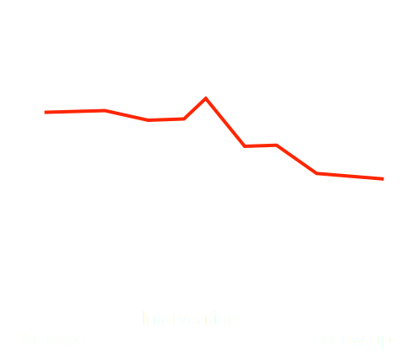
An alternative that fits: SCTS methodology (single case, time series)
Each study is a single case; later they are aggregated.
It’s an “experiment”: each participant is compared to itself (baseline vs intervention-follow up).
Time Series: We collect data along the whole process (daily individualized target complaints).
We complement with video recording and some common outcome assessment tools (OQ-45, Hamilton anxiety scale, BDI).

Slide 8
Why do we say SCTS fits?
Validated in scientific community
Relatively easy to apply by a community of practitioners. 1 case is an important contribution.
4 – 10 cases (by independent researchers) can provide us with international validation for a specific kind of problem
Does not reduce the individual patient to a diagnostic category; includes idiosyncratic outcome measures
Can stimulate the therapeutic process
Provides very valuable data about the change process

Slide 9
How does it work? A step by step guide to the methodological procedure

Slide 10
3 Basic Phases
Baseline
Pre-Contact
Session “0”
2 weeks baseline “waiting” period
Intervention / Therapy
Variable length
Follow up
Final Session
2 weeks follow up “waiting period”
Initial Follow-up session
3-6 months later: second follow-up session

Slide 11
A modular framework
Basic Structure:
Target complaints during baseline, therapy and follow up
General wellbeing & problem scale (e.g. OQ-45.2)
Specific problem scale (e.g. Hamilton anxiety scale)
DSM or CIE-10 diagnosis
Treatment fidelity measure (e.g.: GT Fidelity Scale)
Optional modules. Examples:
Polarities
Relational “co-regulation” between client and therapist
Memory reconsolidation process

Slide 12
Before the process begins: the pre-contact...
Inform about methodology
Abstain from personal contact if possible
Get diagnosis information if present
By phone or at patient intake by collaborator

Slide 13
Session 0: The start of the baseline period...
Target Complaints
Other instruments & procedures
Self report, measured daily (1-2 minutes)
Specific & idiosyncratic problems.
Co-constructed in “session 0”.
The key question is how would you know that you’re getting better?
They must meet the following properties:
Concrete & quantifiable
Frequent
Stable without therapy
Relatively independent from each other
OQ-45
Hamilton anxiety scale / BDI-1
Informed Consent
MINI psychiatric interview to assess presence of psychiatric diagnosis

Slide 14
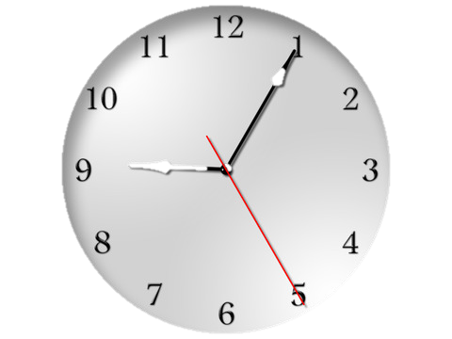
2 weeks pass by...
Patient continues with daily target complaints
Therapist waits...

Slide 15
Therapeutic Phase
Before each session: the patient gives the therapist or receptionist the Target Complaint forms he completed since the last session.
After each session: Therapist completes experience journal
After session 2: WAI short form (patient)
Therapist video-records the session
Variable length, until discharge or initial TC are resolved

Slide 16
Final Session & Follow up
Final session
Follow up (1 & 2)
WAI Short form
Instruct patient to continue with Target Complaints daily form: 2 more weeks after final session
2 weeks pass by...
Collect TC forms
Pre-post instruments again:
OQ-45
BDI (if used in session 0)
Hamilton anxiety scale (if used in session 0)
Second follow-up 3-6 months later (same instruments as follow up nº1)
Notes:
In Chile we added a second follow up 6 months after final session

Slide 17
How do we analyze the data?
For each case
Aggregation for Meta analysis
Pre post change?, how large? | Clinically significant? | Attributable to therapy?
Visual analysis | OQ-45 (RCI) | Linear regression (check for trend)
SMA test for level change (correlation coefficient) | Hamilton or BDI | SMA partial correlation
MBLR |  | Visual analysis of trend
Standardized mean difference Glass’ Δ (designated also as d₁)

Slide 18
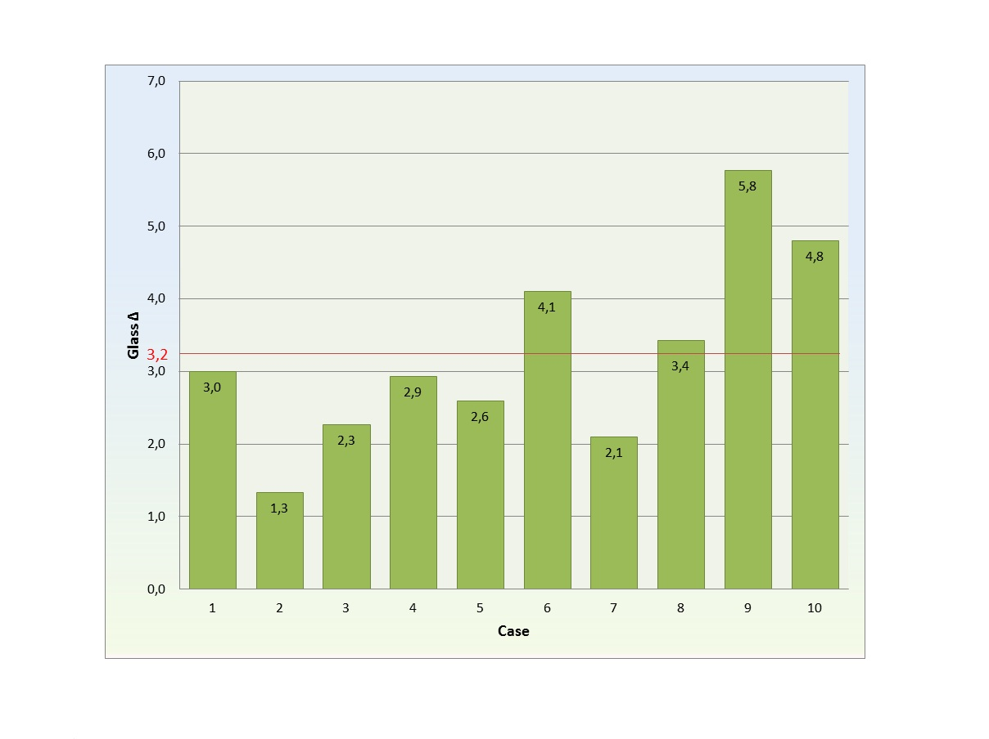
Meta-Analysis
For this purpose we calculate standardized mean difference for each TC. The most commonly applied version of it is Glass’ Δ as wrote Beretvas and Chung (2008) in the review of single-case meta-analyses

Slide 19
Results of the anxiety study
(clients with anxiety problems)

Slide 20
Patient characteristics
Patient nº | Age & gender | Diagnosis | Hamilton score | Nº of sessions
1 | 39, w | Anxiety disorder | 13 (mild) | 14
2 | 30, w | Generalized anxiety | 21 (mod.) | 15
3 | 23, w | Anxiety disorder | 17 (mod.) | 12
4 | 26, w | Alcohol abuse, agoraphobia, depression | 19 (mod.) | 18
5 | 23, w | panic – agoraph., gen. anxiety | 29 (mod.) | 40
6 | 29, w | mixed anxiety and depression | 17 (mod.) | 19
7 | 37, w | mixed anxiety and depression | 39 (severe) | 8
8 | 24, w | Anxiety disorder | 25 (mod.) | 11
9 | 24, w | Adapt dis. with anxiety sympt. | 23 (mod.) | 16
10 | 26, w | panic without agoraphobia | 24 (mod.) | 20
Notes:
(a) 0-5 no ansiedad, (b) 6-14 ansiedad leve, (c) 15-30 ansiedad moderada y (d) ≥ 31 ansiedad grave.

Slide 21
Initial findings with anxiety problems: efficacy results
Patient | Pre post change? | Clinically significant? | Attributable to therapy?
1 | Yes, Large | Yes | Yes (TC4 debatable)
2 | Yes, Small | Debatable | Yes
3 | Yes, Medium | Yes | Yes
4 | Yes, Large | Yes | Yes (TC1 debatable)
5 | Yes, Large | Yes | Yes
6 | Yes, Medium | Yes | Yes
7 | Mixed: Large (TC 1&3) and No (TC2) | Yes | Yes
8 | Yes, Large | Yes | Yes
9 | Yes, Large | Yes | Yes
10 | Yes, Large | Yes | Yes
Notes:
P7, TC2: 2 I can not tolerate the abuse in my workplace; Negative change
OJO MOSTRAR GRÁFICOS???

Slide 22
Case example: Patient 4
Characterization
Initial Scores and Target Complaints
Patient: Woman, 26 y/o, kinesiologyst, single, lives with mother and 2 brothers
Therapist: male, 33 y/o, 3rd year Gestalt training, 6 years experience as psychotherapist
Referred by previous clients of therapist
Private practice setting; research as master’s degree thesis
BDI-1: 11 (mild depression)
Hamilton anxiety scale: 19 (moderate anxiety)
OQ-45: 62 (functional)
MINI & clinical diagnosis: agoraphobia, recurrent depressive disorder, alcohol abuse, Lupus.
Target Complaints:
I feel I’m not acceptable to my family as I am”
“I get desperate when not doing anything”
“I feel frenquently anguished”

Slide 23
Evolution of Target Complaint 3: “I feel frenquently anguished”
Notes:
Revisar...

Slide 24
Exploration of Change Mechanisms
Procedure: Identification of “turning points” in therapy process. Qualitative analysis of:
patient factors
therapist techniques & experience
bond & interaction
extra-therapeutic factors
Key sessions: 3, 6, 12.
Clinical analysis: anxiety was related to fear of stopping activities, feeling sorrow and getting depressed.
Intervention (awareness continuum focused on feelings, polarity work) helped her pay attention to angst and grief, contact true desires and make personal decisions.
Corrective Emotional Experience: Allowing herself to contact what was being avoided decreased anxiety symptoms and improved life satisfaction.
Notes:
Comparison of
patient attitude,
therapist techniques and experience,
bond & interaction
extra-therapy factors

Slide 25
Evolution of General distress

Slide 26
New Phase of the Research Project: Theory Building Case Studies
Aim: to challenge and enrich GT comprehension of anxiety.
Exploration of the Polarities Integration process
First: Construction of an instrument to evaluate the integration of polarities
Then:
Use it to observe good and poor outcome cases
Use it to explore A. Schnake’s work with physical illness.

Slide 27
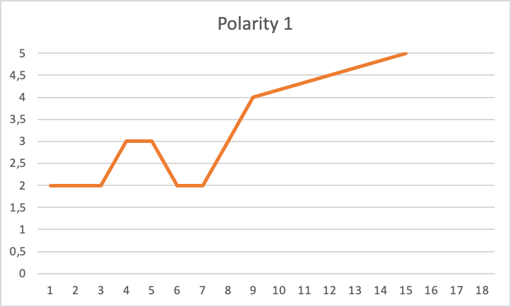
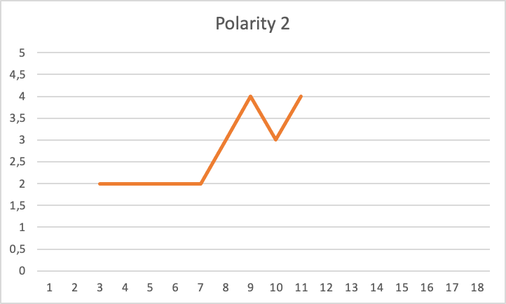
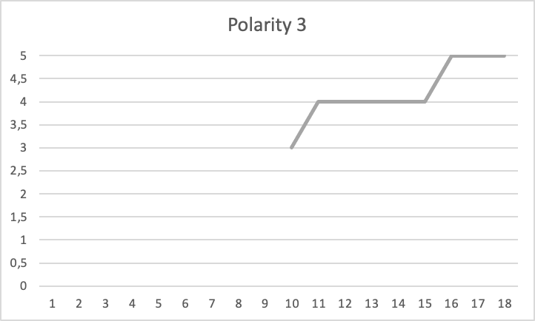
Polarities Integration Process
P1: Active vs Passive
P2: Open vs Closed Off
P3: Dependant vs Independant
Notes:
P1: la paciente aprende que es su culpa que los demás no estuvieran presente ya que ella fue egoísta en el pasado, no dio lo suficiente en sus relaciones, y por esto se sintió sola durante su enfermedad, por lo tanto ahora debe hacer las cosas bien y se exige estar presente para las otras personas.
P2: la experiencia emocional de ser abandonada por sus amistades en este momento doloroso conllevó el aprendizaje implícito de que las amistades solo estarán para los momentos buenos y no para los malos .
P3: es muy difícil actuar en el mundo con autonomía, sintiéndose así muy dependiente para hacerlo. Por otra parte, que su madre sabe mejor que ella lo que es bueno/sano/ correcto para sí misma, consecuentemente, ella misma no sabe hacerlo, y las decisiones que tome por sí misma podrían ser muy negativas para ella, percibiendo al mismo tiempo como algo malo e inaceptable el equivocarse, ya que cuando hace cosas por si misma recibe muchas críticas

Slide 28
Final thoughts

Slide 29
Conclusions
GT could be viable alternative for anxiety difficulties.
Need for more complete attrition data.
Need to use treatment fidelity measure.
Focus on change process and “turning points”.
PBRN: It is possible to do research without special funding.
Outcome research -> F.I.T. & Deliberate Practice

Slide 30
Our learning experience
Importance of regular, personal meetings
Hardest part of learning the SCTS design
Constructing TC
Analyzing data
Use already available resources.
Collaborators with incentives / personal motivation
Institutional support vs training researchers

Slide 31
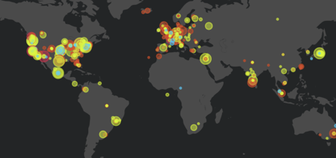
How to join and get support: creating a practice based research network
We need to collaborate to make a real impact.
Our international team has the instruments, instructions, and analysis methods to support individual practitioners or institutions who wish to participate.
Example: In Chile we have collected detailed data of 30+ cases with zero budget…
The power of synergy and creativity facing limited resources

